Slide 1
Can Technical Indicator-based Stock Trading Strategies Perform Better than Top-performing Mutual Funds?
MBAI 5300G - Programming and Data Processing
Group 3 Members:
Hema Appavu Krishnaraju
Sonia Patel

Slide 2
Dataset
Technical Strategies
The dataset is collected from Yahoo Finance from 2013 to 2023(current date) for 10 stocks which are in the Mutual Fund TDB908.
The stocks are : Microsoft(MSFT), Apple(AAPL), Tesla(TSLA), Nvidia(NVDA), Amazon(AMZN), Meta(META), Google(GOOGL), Goog(GOOG), Broadcom Inc(AVGO), Pepsico Inc(PEP).
Relative Strength Index(RSI)
Bollinger Bands (BB)
Simple Moving Average (SMA)
Golden Crossover (GC)
Moving Average Convergence/Divergence(MACD)

Slide 3
Data Cleaning and Preprocessing
The data collected from Yahoo Finance for all the stocks contains columns like Open, High, Low, Close , Adj Close and Volume.
We removed the columns which were unnecessary for our analysis like Volume and Adjusted Close Price.
No null values were found in the dataset.
We have saved the output in an excel file for further analysis.

Slide 4

Exploratory Data Analysis (EDA)

Slide 5
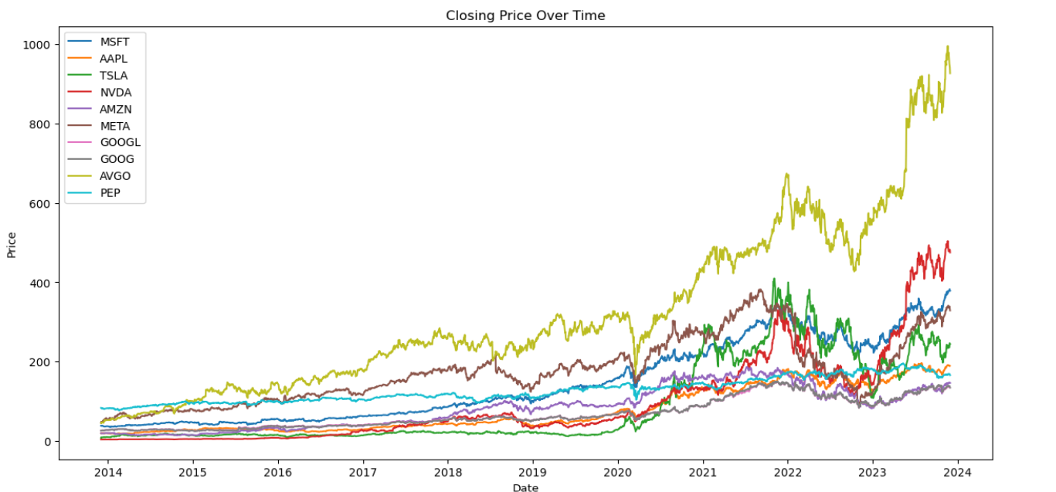
Closing Price of all stocks
Notes:
For calculating the strategies closing price has been considered, AVGO, NVDO following a strong uptrend

Slide 6
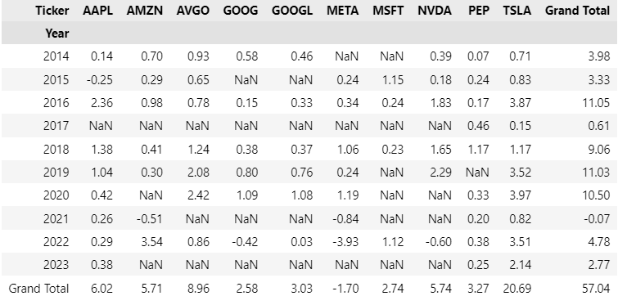
RSI -Sum of Returns Year Wise

Slide 7
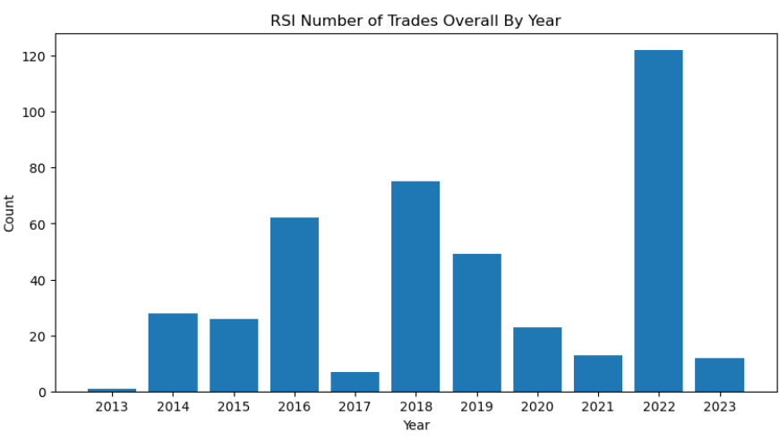
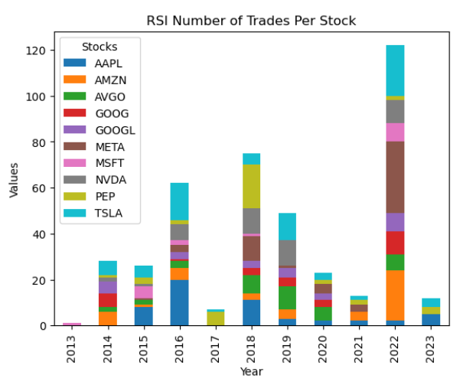
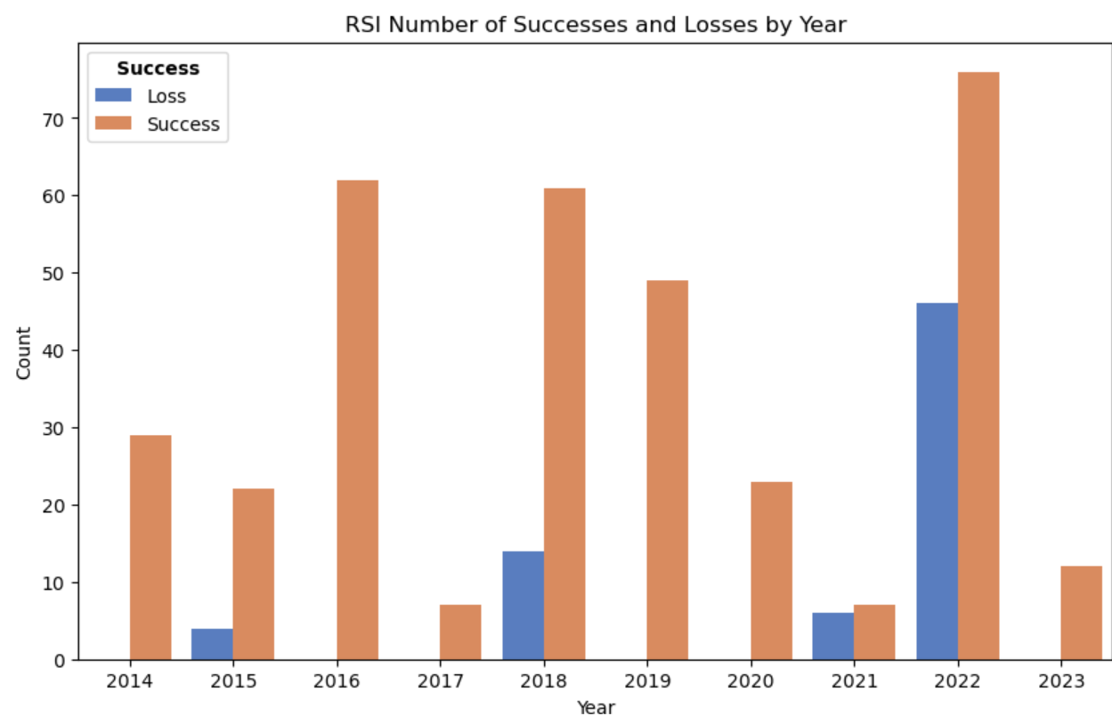
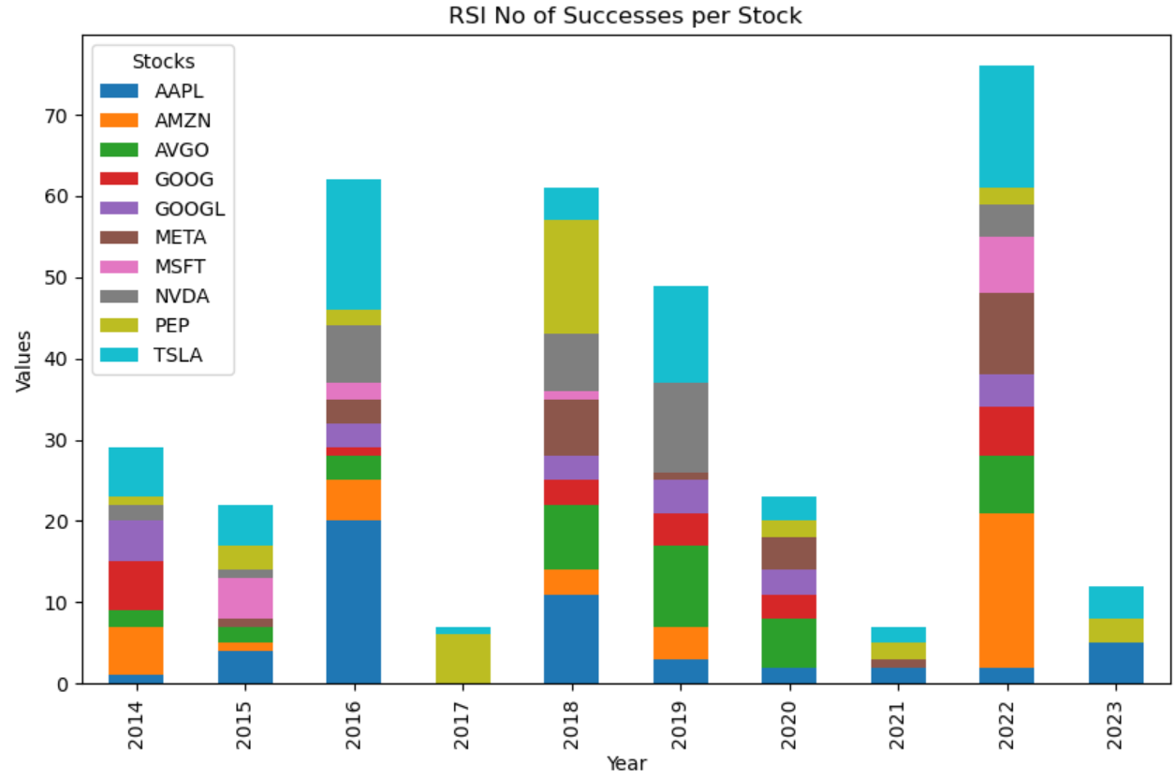
EDA Analysis of RSI
The highest number of holding period is 477 days.
Successful Trades | Unsuccessful Trades
348 | 70
Success Rate (%) | Loss Rate(%)
83.25% | 16.74%

Slide 8
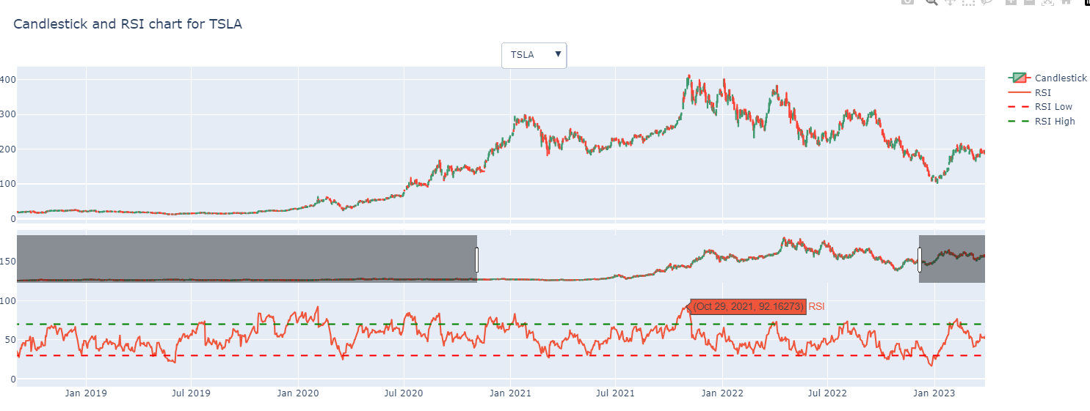
Strategy 1 : RSI
Notes:
For RSI Strategy we have taken the RSI High Level of 70 and RSI Low Level of 30. Level 70 suggests that the stock has been overbought and will soon follow a downtrend . RSI level of 30 suggests that the stock is oversold and will soon see an uptrend.

Slide 9
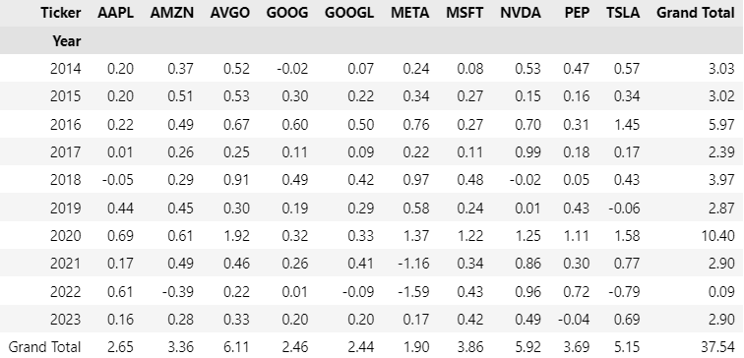
BB -Sum of Returns Year Wise

Slide 10
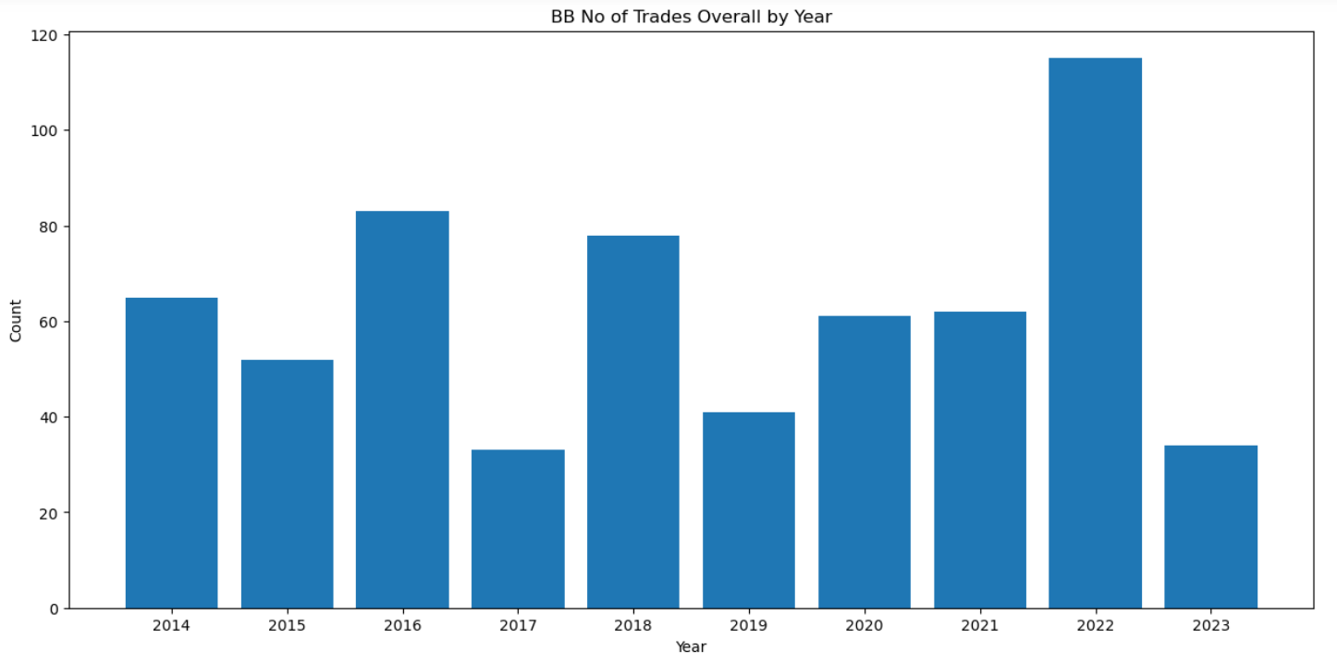
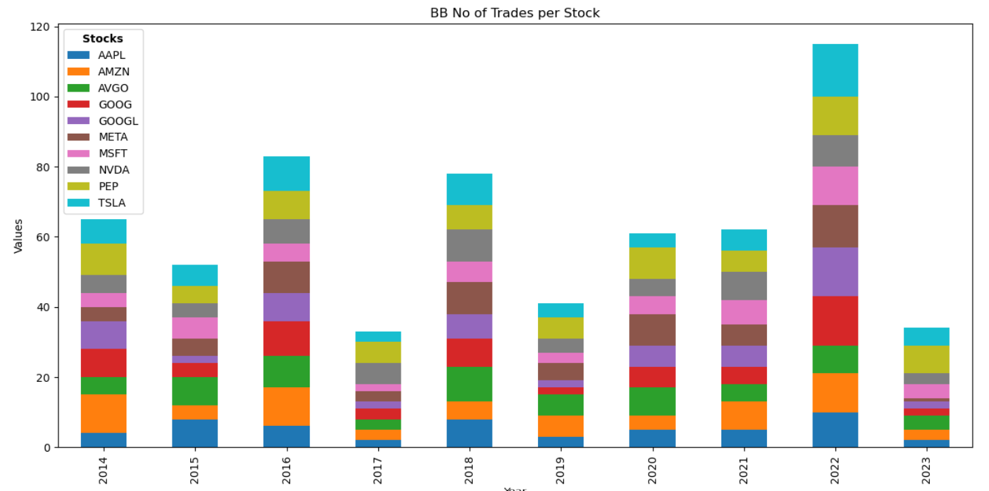
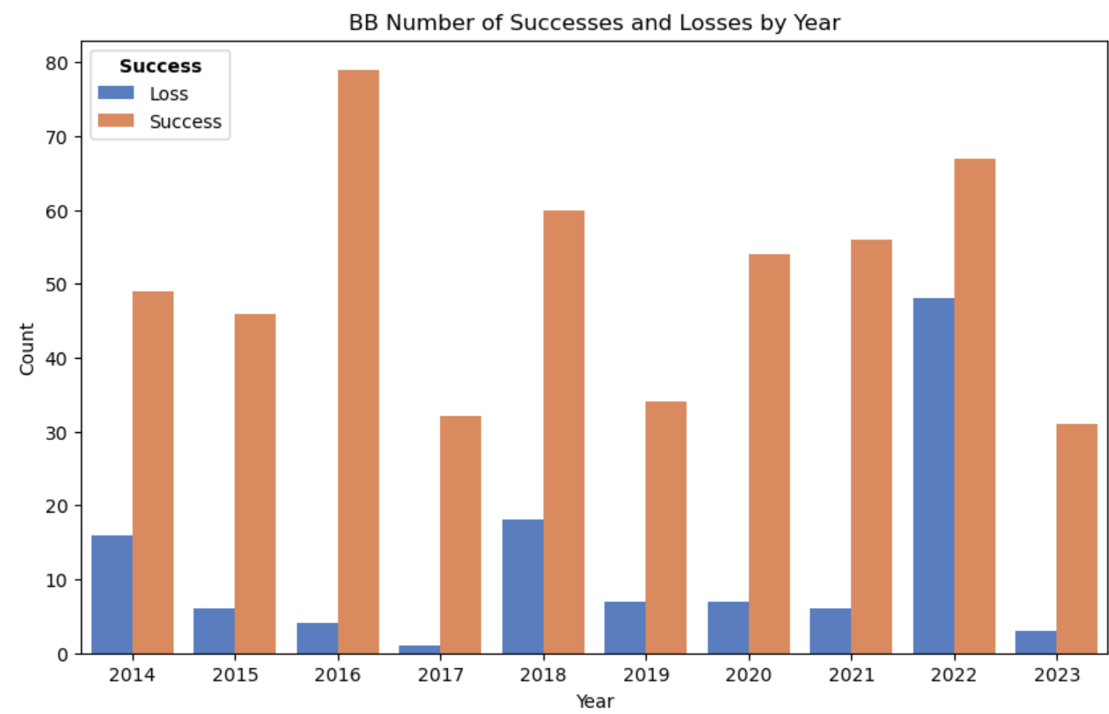
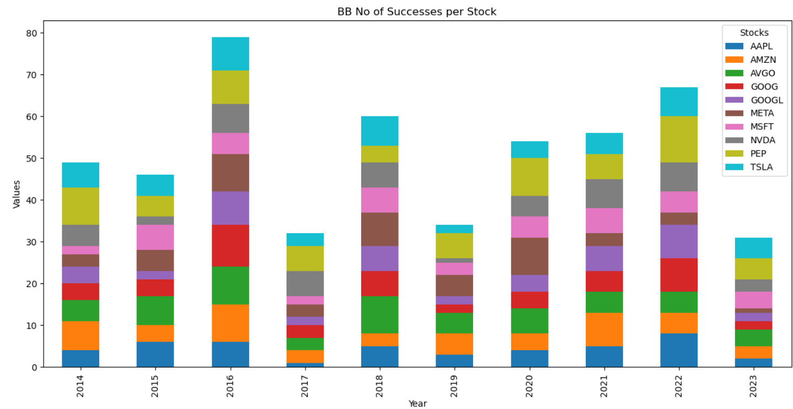
EDA Analysis of Bollinger Bands
The highest number of holding period is 302 days.
Successful Trades | Unsuccessful Trades
508 | 116
Success Rate (%) | Loss Rate(%)
81.41% | 18.54%

Slide 11
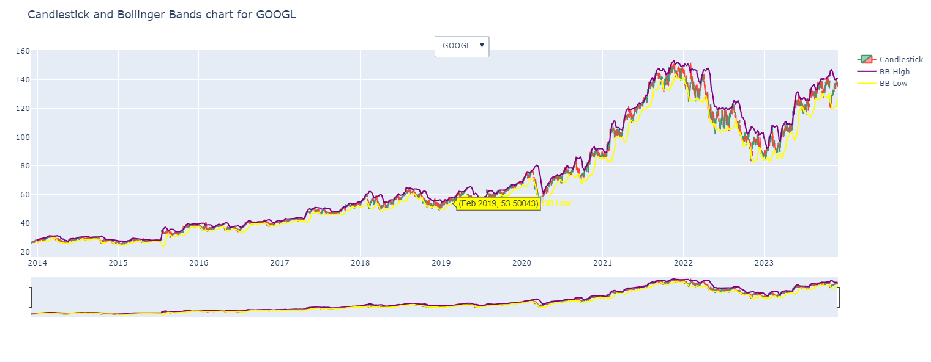
Strategy 2- Bollinger Bands
Notes:
For BB the buy condition for the strategy is when the close price goes below lower band of BB it’s a buy signal and sell when it crosses the high band of BB. It is a volatityl indicatore indicating how volatile the market is

Slide 12
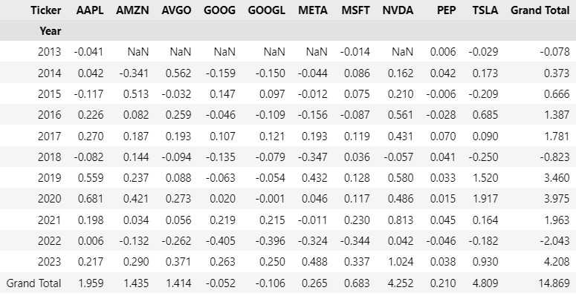
SMA-Sum of Returns Year Wise

Slide 13
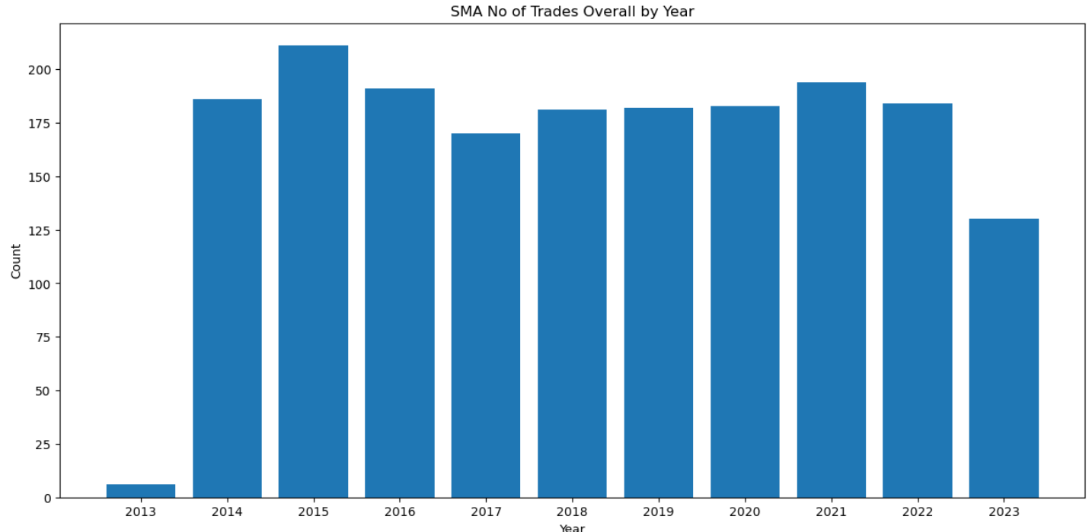
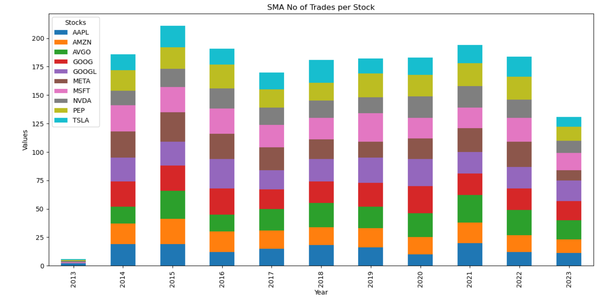
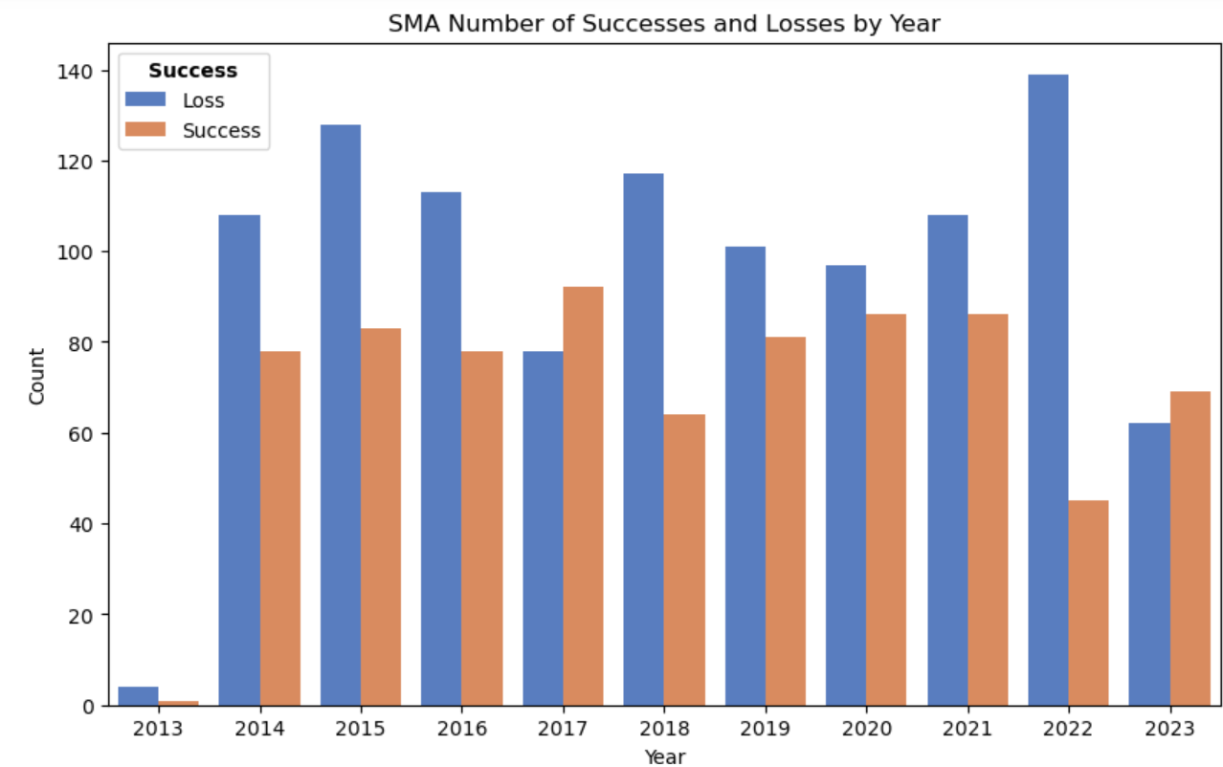
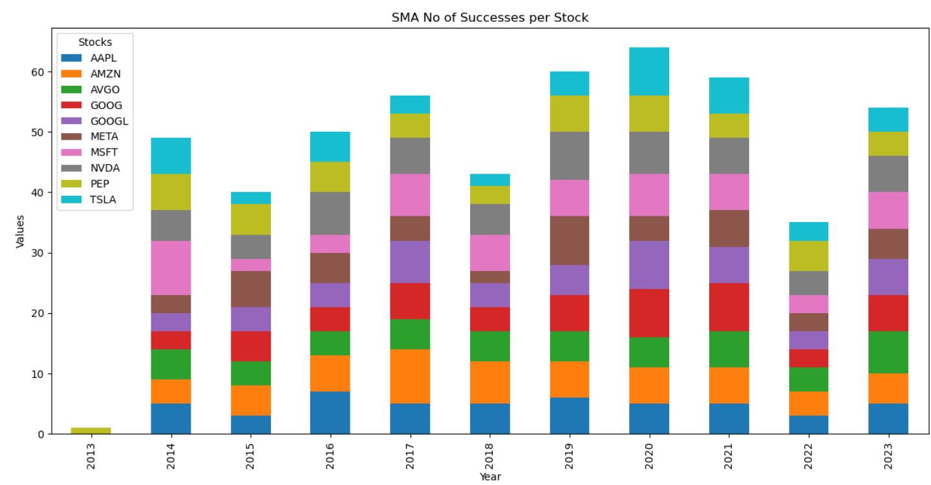
EDA Analysis of SMA
The highest number of holding period is 108 days.
Successful Trades | Unsuccessful Trades
763 | 1055
Success Rate(%) | Loss Rate(%)
41.56% | 58.03%

Slide 14
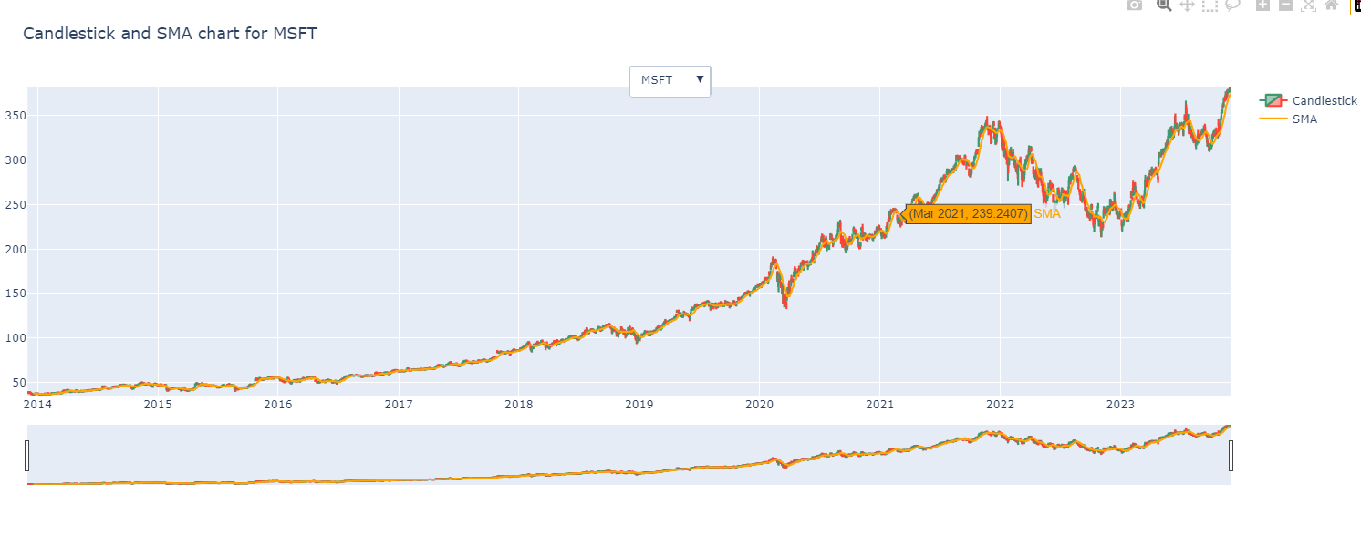
Strategy 3- Simple Moving Average
Notes:
SMa strategy follows an average for 14 period window. The buy condition for the Simple Moving Average (SMA) strategy is typically when the price crosses above the SMA line. And sell when below the SMA line showing a start of downtrend

Slide 15
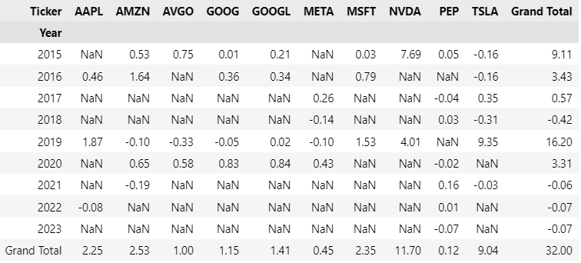
GC-Sum of Returns Year Wise

Slide 16
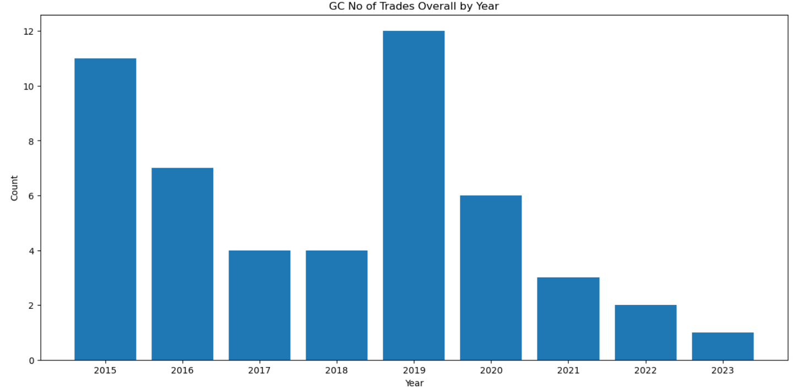
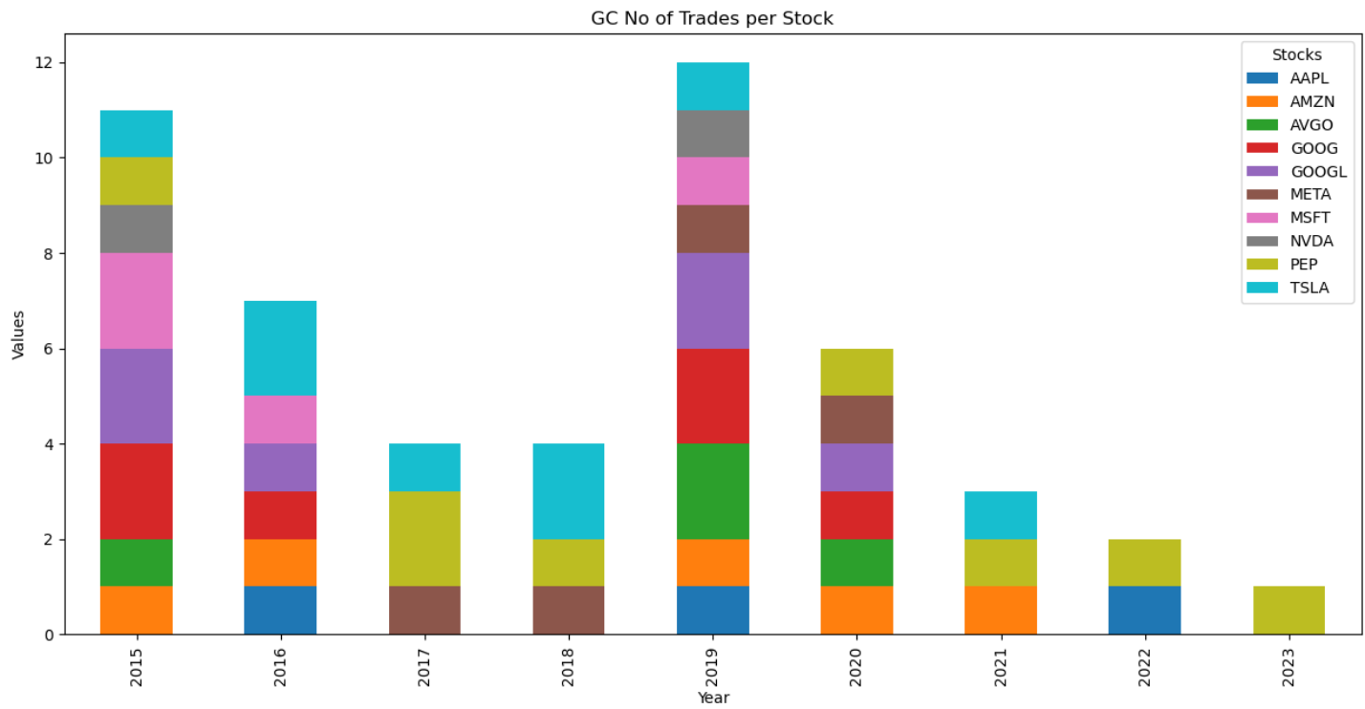
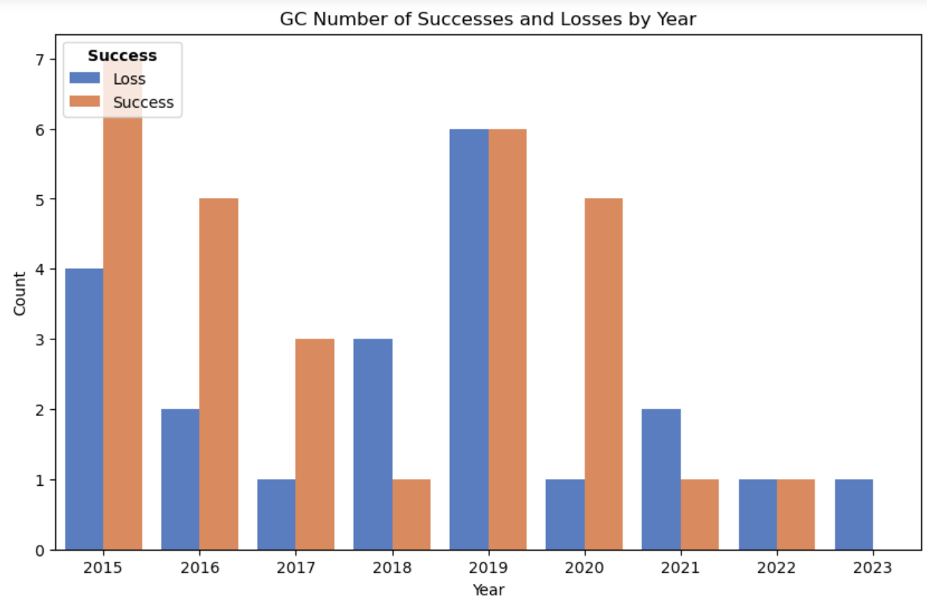
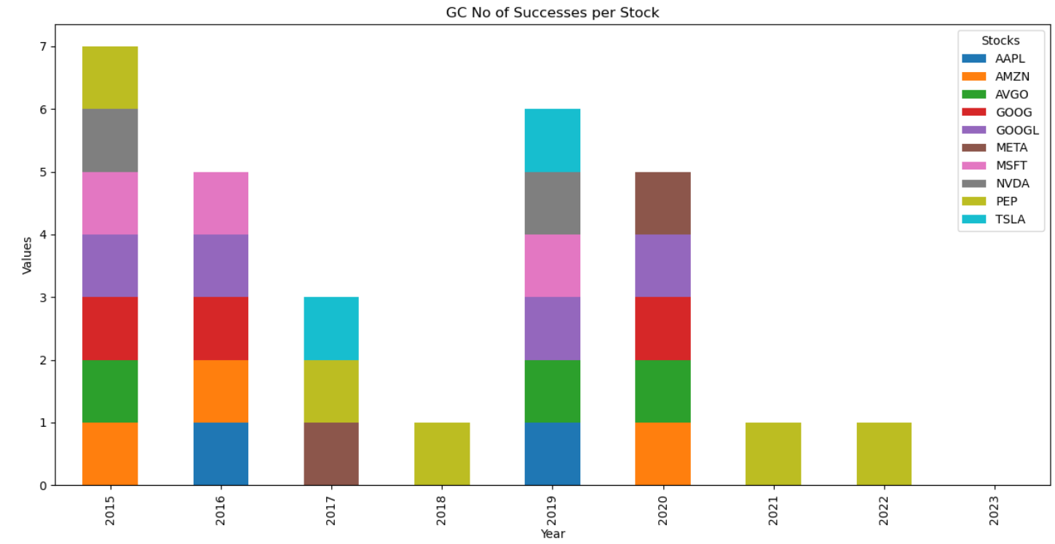
EDA Analysis of GC
The highest number of holding period is 1155 days.
Successful Trades | Unsuccessful Trades
29 | 21
Success Rate (%) | Loss Rate(%)
58% | 42%

Slide 17
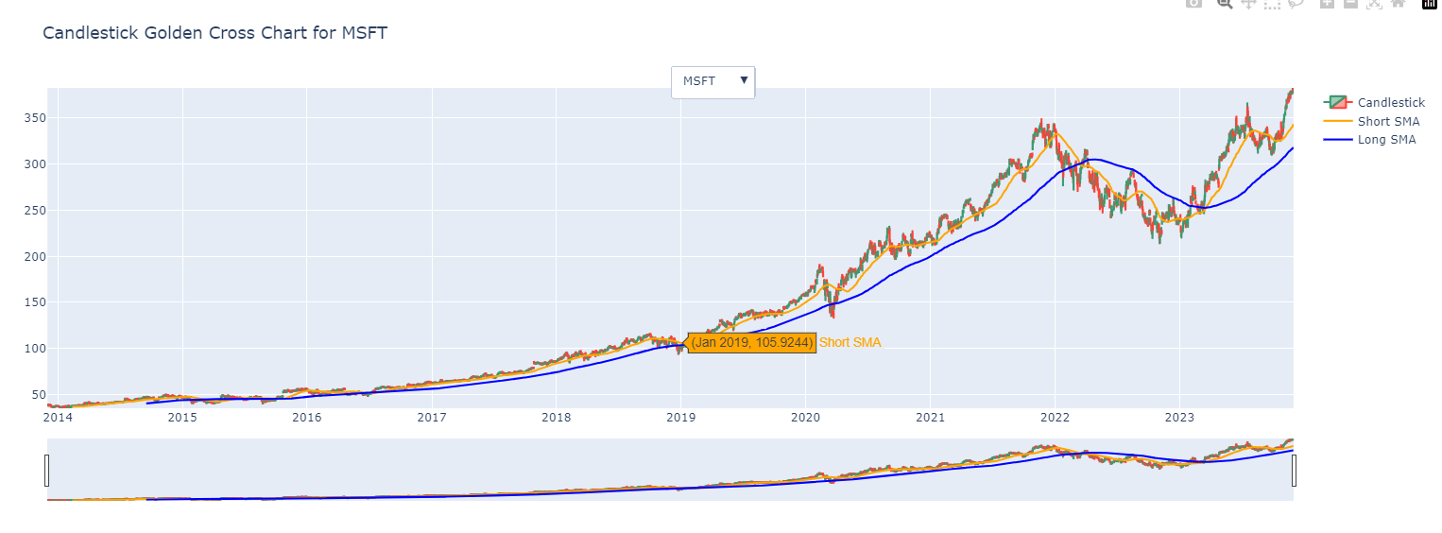
Strategy 4-Golden Crossover
Notes:
Buy condition when 50 sma crosses 200 sma from below and sell when 50 crosses 200 SMA below (downwards)

Slide 18
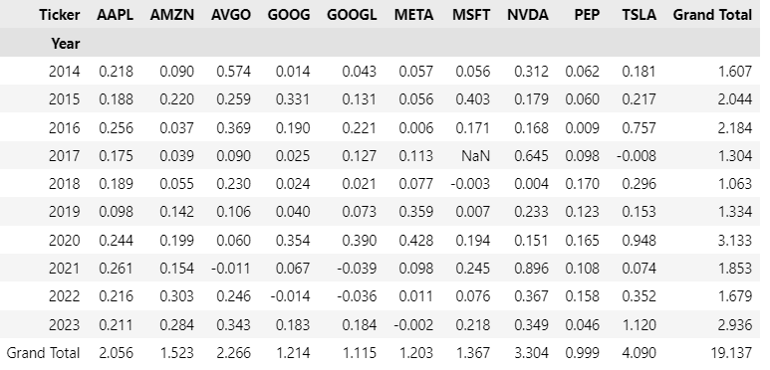
MACD - Sum of Returns Year Wise

Slide 19
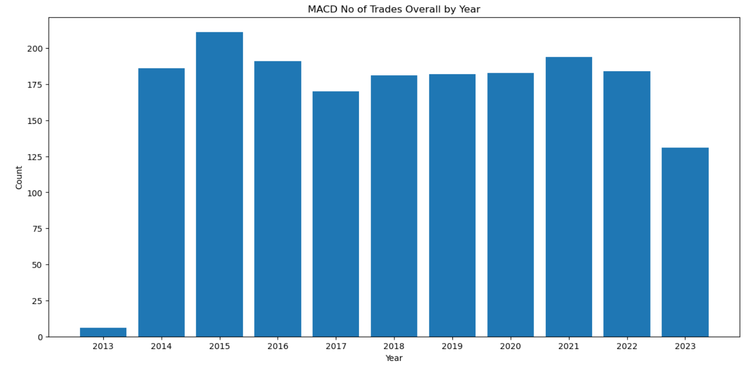
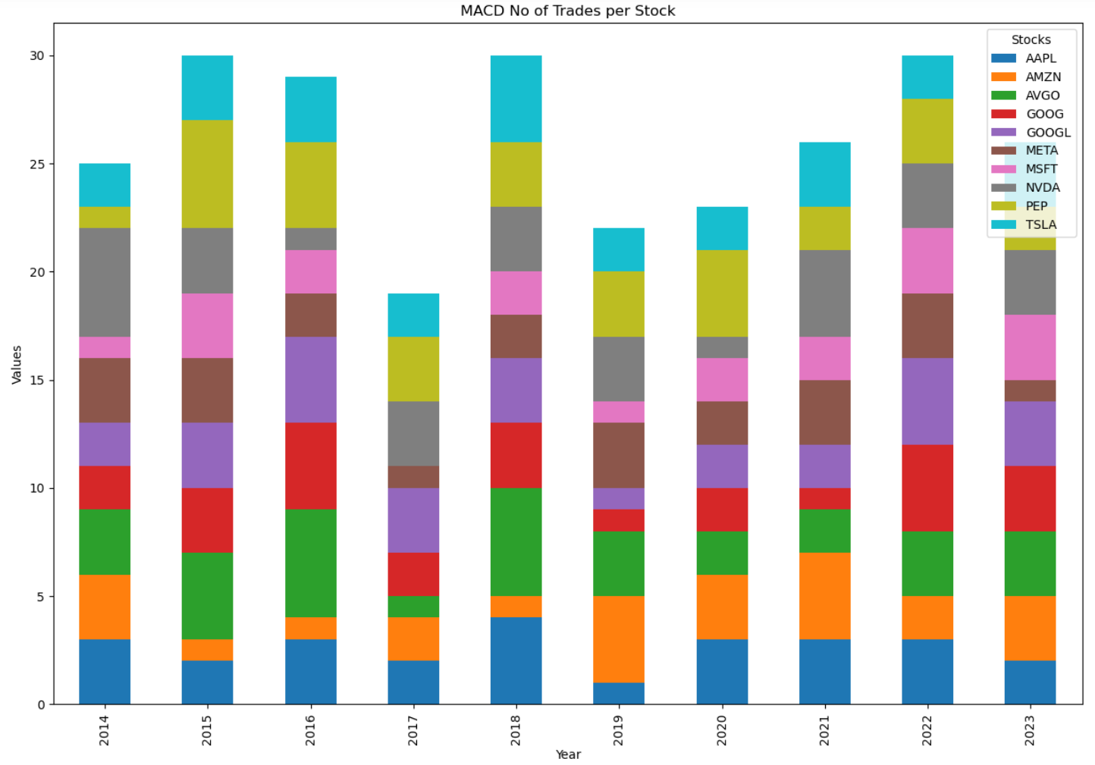
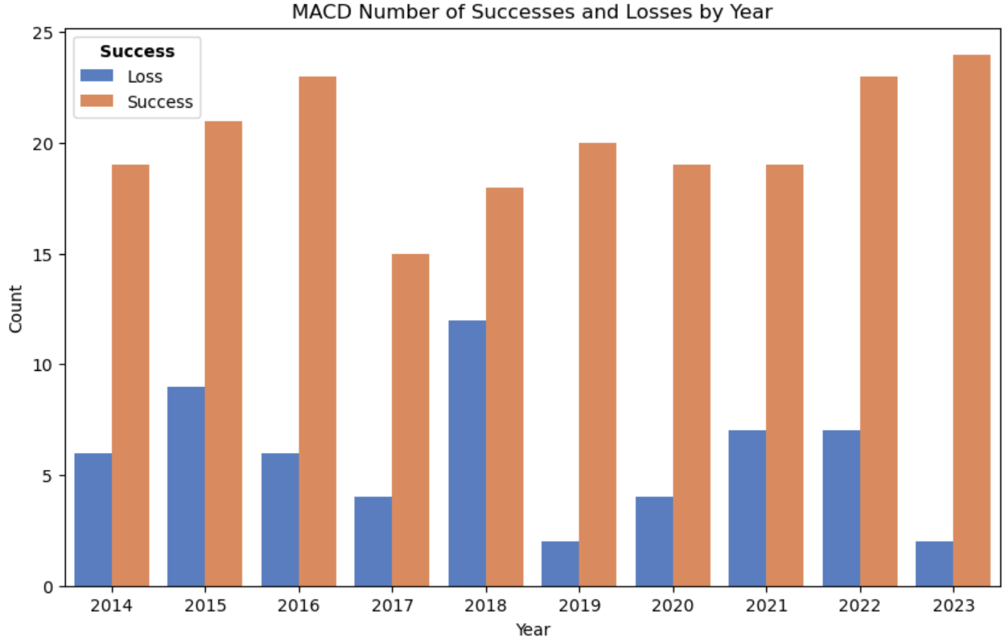
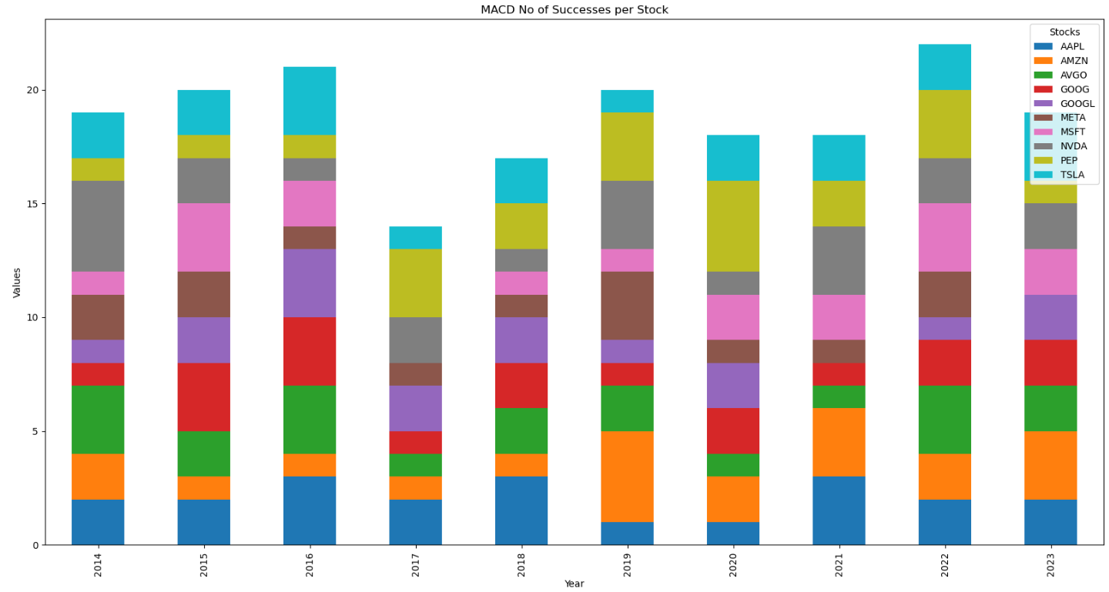
EDA Analysis of MACD
The highest number of holding period is 77 days.
Successful Trades | Unsuccessful Trades
201 | 59
Success Rate (%) | Loss Rate(%)
77.30% | 22.69%

Slide 20
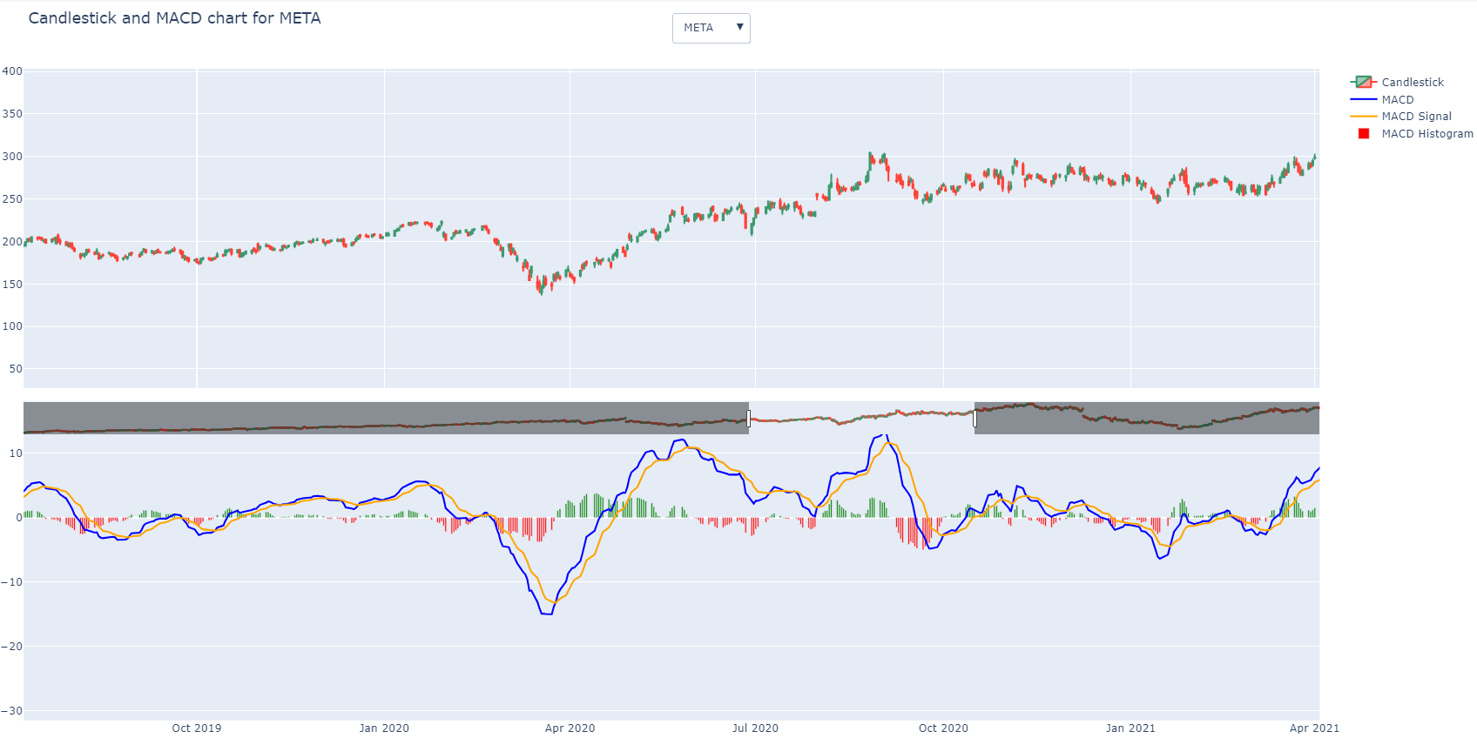
Strategy 5 - MACD
Notes:
The buy condition is when the MACD line crosses above the Signal line (indicating bullish momentum) and the MACD line is below zero.Sell Condition is MACD line crosses below the Signal line (indicating bearish momentum), the MACD line is above zero

Slide 21
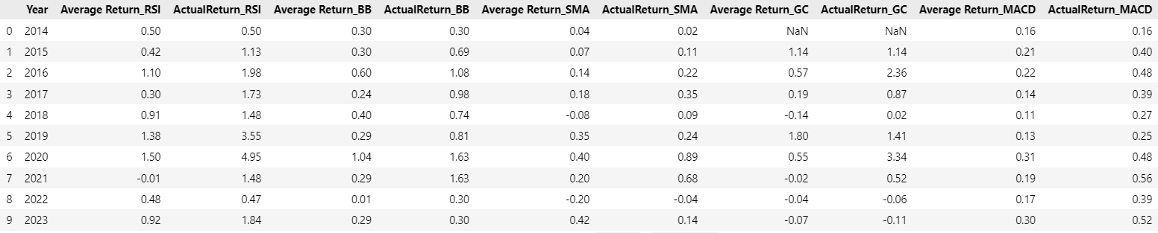
Average and Actual Returns For All Strategies

Slide 22
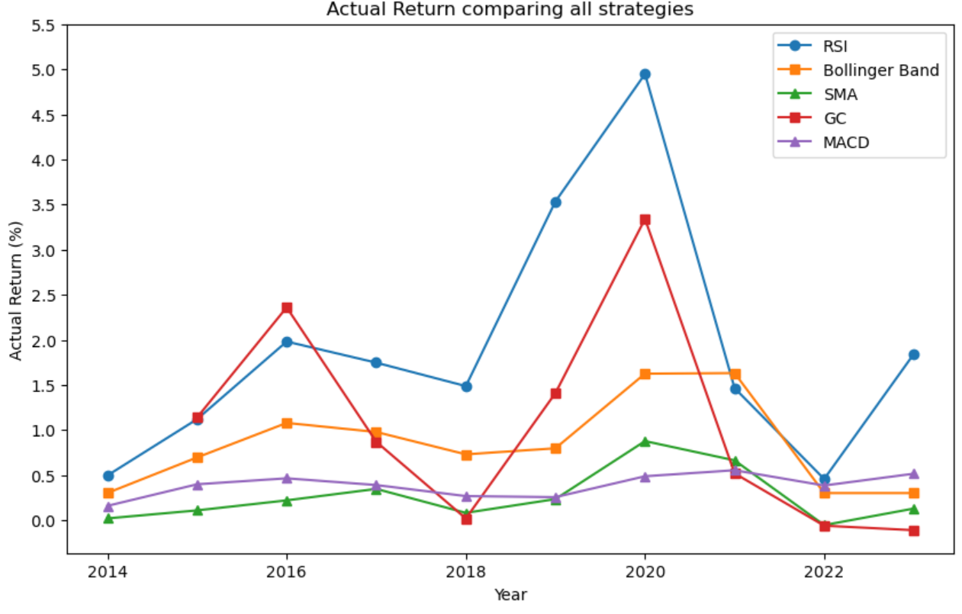
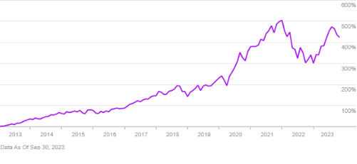
Actual Return vs TD Mutual Fund -TDB908

Slide 23
Key Insights
The highest Success Rate for trades was for RSI Strategy for 10 years which was 83%.
The highest Loss Rate for Trades was for SMA strategy for 10 years which was 58%.
The highest holding period for Golden Crossover was of 1155 days with very low success rate.
Actual return for all 10 years was highest for RSI Strategy which was around 19% and the lowest was SMA with 2.7%

